Slide 1
Present Continuous Tense

Slide 2
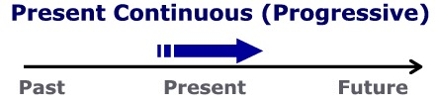
Present Continuous

Slide 3
Uses
1) actions happening at the moment of speaking (now, at the moment)
Time expressions for Present Progressive:
Now
Right now
In this moment

Slide 4
Form:
am
is
are
Subject
verb + -ing

Slide 5
THE PRESENT CONTINUOUS TENSE
AFFIRMATIVE: Play
I | am ‘m | playing
You We They | are ‘re
He She It | is ‘s

Slide 6
THE PRESENT CONTINUOUS TENSE
play
Right now he is playing football.

Slide 7
Form:
am
is
are
Subject
not
verb + -ing

Slide 8
THE PRESENT CONTINUOUS TENSE
Right now he is not playing soccer.
He is running.

Slide 9
THE PRESENT CONTINUOUS TENSE
INTERROGATIVE: Play
Am | I | playing?
Are | you we they
Is | he she it
Yes / No | I | am ‘m not | playing
 | You We They | are aren’t
 | He She It | is isn’t

Slide 10
Questions:
Am I playing soccer?
Are you playing soccer?

Slide 11
THE PRESENT CONTINUOUS TENSE
INTERROGATIVE: Play
What Where Why | Am | I | playing?
 | Are | you we they
 | is | he she it
I am …
You are…
He/she/it is…
We are…
They are…

Slide 12
WHAT IS SHE DOING?
draw
She is drawing a picture

Slide 13
4-2 SPELLING OF -ING
END OF VERB -ING FORM
*
Rule
1
A CONSONANT + -e
DROP THE -e and ADD -ing
smil
ing
e
example:
*
b,c,d,f,g,h,j,k,l,m,n,p,q,r,s,t,v,w,x,y,z

Slide 14
4-2 SPELLING OF -ING
END OF VERB -ING FORM
Rule
1
A CONSONANT + -e
DROP THE -e and ADD -ing
din
ing
e
example:

Slide 15
4-2 SPELLING OF -ING
END OF VERB -ING FORM
*
Rule
2
ONE VOWEL + ONE CONSONANT
DOUBLE THE CONSONANT and ADD -ing
sit
t
ing
example:
exception: do not double w, x, and y
a,e,i,o,u
*
pay
ying
?
ing

Slide 16
4-2 SPELLING OF -ING
END OF VERB -ING FORM
Rule
2
ONE VOWEL + ONE CONSONANT
DOUBLE THE CONSONANT and ADD -ing
plan
n
ing
ing
example:

Slide 17
4-2 SPELLING OF -ING
END OF VERB -ING FORM
Rule
3
TWO VOWELS + ONE CONSONANT
ADD -ing;
DO NOT DOUBLE THE CONSONANT
read
ing
example:

Slide 18
4-2 SPELLING OF -ING
END OF VERB -ING FORM
Rule
3
TWO VOWELS + ONE CONSONANT
ADD -ing;
DO NOT DOUBLE THE CONSONANT
sleep
ing
example:

Slide 19
4-2 SPELLING OF -ING
END OF VERB -ING FORM
Rule
4
TWO CONSONANTS
ADD -ing;
DON’T DOUBLE THE CONSONANT
brush
ing
example:

Slide 20
4-2 SPELLING OF -ING
END OF VERB -ING FORM
Rule
4
TWO CONSONANTS
ADD -ing;
DON’T DOUBLE THE CONSONANT
drink
ing
example:

Slide 21
Make –ing forms of each verb given.
begin
rub
listen
lie
swim
study
happen
get
use
admit
try
decide
come
put

Slide 22
–ing forms
beginning
rubbing
listening
lying
swimming
studying
happening
getting
using
admitting
trying
deciding
coming
putting

Slide 23
ACTIONS THAT ARE HAPPENING AT PRESENT (1)
They are dancing right now.

Slide 24
A man is riding a bike

Slide 25
The dog is walking.

Slide 26
Shruti ___________ the piano.
is playing

Slide 27
The horse is running.
The kangaroo is jumping.

Slide 28

4-1 Let’s Practice
read
What is the girl doing?
is reading
She _________.

Slide 29
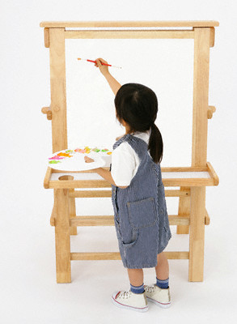
4-1 Let’s Practice
paint
What is the girl doing?
is painting
She _________.

Slide 30
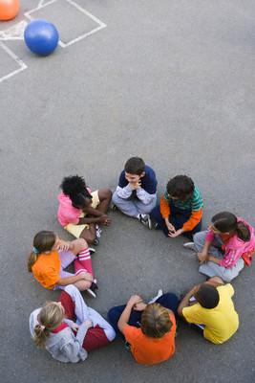
4-1 Let’s Practice
play
What are the children doing?
They _________.
are playing

Slide 31
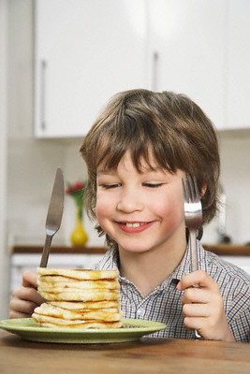
4-1 Let’s Practice
eat
What is the boy doing?
He _______.
is eating

Slide 32
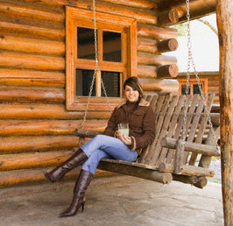
4-2 SPELLING OF -ING
She is sitting.

